Slide 1




FASHI N F RESIGHT: PREDICTING CUSTOMER ENGAGEMENT THROUGH BEHAVIOR
Bhuvana Chandrika Kothapalli
Rajkumar Rajavel
Sai Lakshmi Appala Naga
Sanjhana Rangaraj
Santhosh Kumar Ramkumar
Note: Due to usage of certain design elements, navigating through presentation is easier using full screen mode

Slide 2

AGENDA
01
02
03
04
Problem Statement & Objective
Data Description
Feature Importance
Uplift Modelling
05
06
07
08
RFM Segmentation
Clustering &
Targeting Strategy
Summary &
Scope
Appendix

Slide 3
AGENDA
01
02
03
04
Problem Statement & Objective
Data Description
Feature Importance
Uplift Modelling
05
06
07
08
RFM Segmentation
Clustering &
Targeting Strategy
Summary &
Scope
Appendix

Slide 4


PROBLEM STATEMENT
Our e-commerce fashion brand offers a diverse range of apparel for both men and women. As our customer demographics are diverse, targeted ad campaigns offer more effective engagement with different customer segmentation.
We recently tested two email ad campaigns focused separately on promoting men's and women's merchandise over a 2-week period. The problem at hand is to identify the factors contributing to the differing campaign performance and develop targeting strategies to improve customer engagement through ad campaigns.
OBJECTIVES
Assess the incremental value driven by the men's and women's email ad campaigns
Identify the customer segments most receptive to each campaign
Inform strategies for crafting targeted ad campaigns optimized for specific customer demographics
The goal is to boost campaign performance by seeing gains in targeting through a segmented approach.
PROBLEM STATEMENT & OBJECTIVE

Slide 5
AGENDA
01
02
03
04
Problem Statement & Objective
Data Description
Feature Importance
Uplift Modelling
05
06
07
08
RFM Segmentation
Clustering &
Targeting Strategy
Summary &
Scope
Appendix

Slide 6
DATA DESCRIPTION
The dataset contains information related to customer transactions and their associated attributes.
01
Recency: Represents the number of months since the customer's last transaction. This information is crucial for understanding customer engagement and retention.
02
History: Actual dollar value spent in the past year.
03
Men/Women: Purchase information of merchandises purchased in the past, with data on both men and women, as well as separate categories for only men and only women.
04
Area: Classifies region as Urban, Suburban, or Rural.
05
Newbie: 1/0 indicator, 1 = New customer in the past twelve months.
06
Channel: Describes the channels the customer purchased from in the past year.
07
Segment: Describes the email campaign the customer received - Men's, Women’s, or No email
08
Visit: Indicates if the customer visited the website in the following two weeks, or not. This variable describes the activity in the two weeks following delivery of email campaign.
Dataset contains 64,000 customers who last purchased within twelve months

Slide 7
‘GLORIFIED’ CROSSTABS
RECENCY QUARTILES
CHANNEL
AREA
% Composition
% Composition
% Composition
Avg. % Visits
Avg. % Visits
Avg. % Visits
NEWBIE
SEGMENT
PAST PURCHASES
% Composition
% Composition
% Composition
Avg. % Visits
Avg. % Visits
Avg. % Visits

Slide 8
AGENDA
01
02
03
04
Problem Statement & Objective
Data Description
Feature Importance
Uplift Modelling
05
06
07
08
RFM Segmentation
Clustering &
Targeting Strategy
Summary &
Scope
Appendix

Slide 9
FEATURE IMPORTANCE
Calculated feature importance through logistic regression to identify which customer attributes have the most significant influence on driving engagement, enabling us to focus our marketing efforts and resources on the key drivers of engagement behavior
(Clearly) Most Important
1
Variable | Min | Max | Difference | % Importance
History | 0.015 | 1.673 | 1.658 | 31%
Women | 0.000 | 0.726 | 0.726 | 14%
Segment | -0.646 | 0.000 | 0.646 | 12%
Men | 0.000 | 0.572 | 0.572 | 11%
Recency | -0.557 | 0.000 | 0.557 | 10%
Newbie | -0.558 | 0.000 | 0.558 | 10%
Area | -0.372 | 0.000 | 0.372 | 7%
Channel | -0.100 | 0.166 | 0.266 | 5%
History with 31% importance
2
Other Important
Women and Segment signify the type of purchase in the past and email campaign received
Least important
3
Area and Channel have little impact on visit generation
Notes:
From the above table, it is evident that certain features hold significant importance in influencing customer behavior and outcomes in our project.
"History" stands out as the most crucial feature with a 31% importance, emphasizing the pivotal role of a customer's spending history.
Additionally, "Womens" and "Segment" contribute 14% and 12%, respectively, underlining the significance of gender preferences and customer segmentation in tailoring effective marketing strategies.
However, "Area" and "Channel" exhibit relatively low feature importance, contributing only 7% and 5%, respectively, to the model's predictive power. Hence, we dropped them to simplify our model.
This selective feature inclusion ensures that our model focuses on the most influential attributes, leading to a simpler, more efficient, and interpretable model.

Slide 10
AGENDA
01
02
03
04
Problem Statement & Objective
Data Description
Feature Importance
Uplift Modelling
05
06
07
08
RFM Segmentation
Clustering &
Targeting Strategy
Summary &
Scope
Appendix

Slide 11

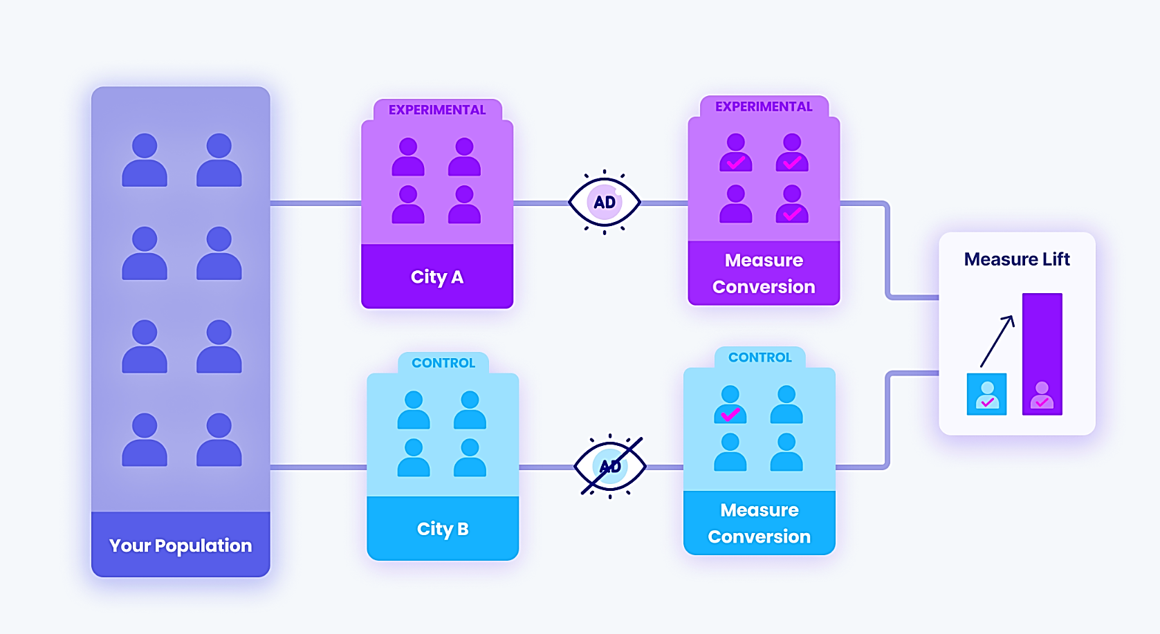

. . . . . .
. . . . . .
. . . . . .
UPLIFT MODEL
An uplift model is a predictive technique used to determine the impact of a marketing campaign or intervention on customer behavior
Treatment Responders (TR)
Treatment Non-Responders (TN)
Customers that will purchase only if they have an offer
Customers that will not purchase despite targeting
Ad Campaign
Control Responders (CR)
Control Non-Responders
Customer that will purchase without an offer
Customers that will not purchase if they do not receive an offer
No Ad Campaign
Uplift Score = P_{TR} + P_{CN} - P_{TN} - P_{CR}

Slide 12
UPLIFT MODELING USING PREDICTIVE ANALYTICS
Feature Engineering
Modeling
From the raw data, we know the customers who were part of the 2-week ad campaign (Treatment group) and who were not sent any ads (Control group)
We further classified these customers into
Treatment responders: Received ad and visited our website (within 2 weeks)
Treatment Non-responders: Received ad and did not visit our website
Control Responders: Did not receive ad but still visited our website
Control Non-responders: Did not receive ad and did not visit the website
This is our 4-class target variable that needs to be estimated using predictive modeling
All the features in our dataset (even the least important metrics Area and Channel) were considered for modeling
The features were encoded appropriately before being fed into the model
As this is a multi-class classification problem, we ran logistic regression and XGBoost models to predict the class probabilities
Results from the XGBoost model was picked due to lower prediction error

Slide 13
Calculating uplift scores
EXAMPLES OF CALCULATION OF UPLIFT SCORES
Uplift Score = P_{TR} + P_{CN} - P_{TN} - P_{CR}
P
P_{TR} = 1.5%
P_{CN} = 65.3%
P_{TN} = 32.6%
P_{CR} = 0.4%
P_{TR} = 9.1%
P_{CN} = 4.3%
P_{TN} = 80.7%
P_{CR} = 5.7%
P_{TR} = 1.2%
P_{CN} = 6.8%
P_{TN} = 19%
P_{CR} = 72.8%
Control Non-Responders
Treatment Non-Responders
Control Responders
Target Responders
P_{TR} = 85.1%
P_{CN} = 3.4%
P_{TN} = 10.6%
P_{CR} = 0.7%
Uplift Score = 77.2%
Uplift Score = 33.81%
Uplift Score = -72.9%
Uplift Score = -83.75%

Slide 14
Calculating uplift scores
CALCULATING BASELINE DOLLAR UPLIFT PER CUSTOMER –
PITTING CAMPAIGN vs. CAMPAIGN
. . . . . .
. . . . . .
. . . . . .
Men’s Ad Campaign
Total Targeted Customer Count | 21,307
Discount Conversion Uplift | 7.66%
Discount Order Uplift | 1,631
Discount Revenue Uplift | $40,797
Revenue Uplift Per Targeted Customer | $1.91
. . . . . .
. . . . . .
. . . . . .
Women’s Ad Campaign
Total Targeted Customer Count | 21,387
Discount Conversion Uplift | 4.52%
Discount Order Uplift | 967
Discount Revenue Uplift | $24,185
Revenue Uplift Per Targeted Customer | $1.13

Slide 15
AGENDA
01
02
03
04
Problem Statement & Objective
Data Description
Feature Importance
Uplift Modelling
05
06
07
08
RFM Segmentation
Clustering &
Targeting Strategy
Summary &
Scope
Appendix

Slide 16
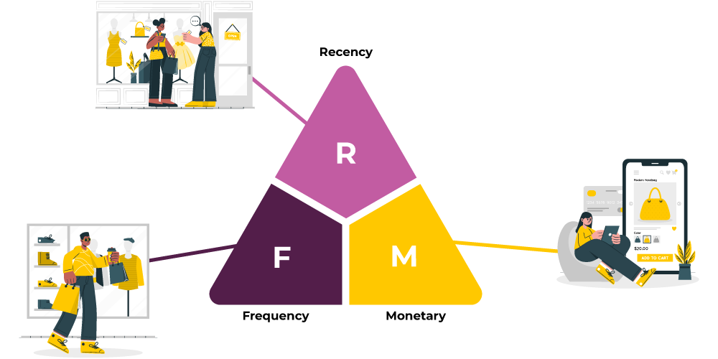
R(F)M SEGMENTATION
Recency
Our data is divided into 4 ‘quarter’ groups - each bucket incrementally consisting of 3 months since last purchase
18% of our visits are caused by customers in the most recent (last purchase within 3 months) visit group whereas only 11% is from the rare (last purchase within 9-12 months) group
Frequency
No information was available on the frequency of the customer purchases, neither could it be engineered from available information
Monetary Value
Divided into quartiles based on total historic spend
This feature was earlier attributed as the most important factor for visit
Notes:
Recency
How recent was the customer's last purchase?
Frequency
How often did the customer make a purchase in a given time period?
Monetary Value
How much money did the customer spend in a given time period?

Slide 17
R(F)M SEGMENTATION
RM Segment | Count | Avg. % Visits
11 | 11,442 | 16%
12 | 4,811 | 21%
13 | 3,528 | 19%
14 | 2,612 | 21%
21 | 8,864 | 13%
22 | 2,859 | 17%
23 | 1,708 | 17%
24 | 761 | 17%
31 | 9,731 | 11%
32 | 2,635 | 16%
33 | 1,254 | 14%
34 | 394 | 15%
41 | 10,001 | 11%
42 | 2,309 | 14%
43 | 882 | 16%
44 | 209 | 20%
Total | 64,000 | Avg = 14%
While the results of the RM segmentation offer some hints on which segments yield better results, there is not a lot of range in the results and most segments performed similar to the overall average.
Notes:
Recency
How recent was the customer's last purchase?
Frequency
How often did the customer make a purchase in a given time period?
Monetary Value
How much money did the customer spend in a given time period?

Slide 18
AGENDA
01
02
03
04
Problem Statement & Objective
Data Description
Feature Importance
Uplift Modelling
05
06
07
08
RFM Segmentation
Clustering &
Targeting Strategy
Summary &
Scope
Appendix

Slide 19
CLUSTERING USING K-MEANS
Approach
As per the feature importance derived using the logistic regression model, we are dropping Area and Channel for clustering
The newly engineered uplift score feature is included
To decide the number of clusters, we looked at within cluster to between cluster inertia - decided to have seven clusters
Cluster | #Customers | Avg. % Visits
Segment 1 | 1,381 | 53%
Segment 2 | 5,725 | 24%
Segment 3 | 6,904 | 18%
Segment 4 | 15,711 | 15%
Segment 5 | 12,430 | 11%
Segment 6 | 12,272 | 10%
Segment 7 | 9,577 | 11%
Total | 64,000 | Avg = 14%

Slide 20
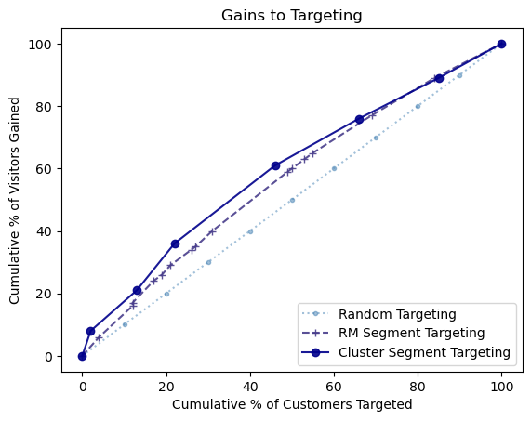
Calculating uplift scores
COMPARING GAINS TO TARGETING

Slide 21
CLUSTERING USING K-MEANS
STEADY SAILING…
Segment | Ad Campaign Exposure ( % Visited | # Total Customers ) |  |  | Revenue Uplift per Customer
 | Men's Campaign | Women's Campaign | None | Men's Campaign | Women's Campaign | Delta
1 | 89% | 449 | 88% | 337 | 6% | 595 | $20.62 | $20.51 | $0.11
2 | 31% | 1964 | 23% | 1851 | 7% | 3089 | $5.97 | $3.89 | $2.08
3 | 29% |1913 | 24% | 1900 | 18% | 1912 | $2.91 | $1.53 | $1.38
4 | 17% | 5204 | 17% | 5316 | 11% | 5191 | $1.51 | $1.44 | $0.07
5 | 13% | 4197 | 14% | 4163 | 7% | 4070 | $1.33 | $1.62 | ($0.29)
6 | 12% | 4136 | 8% | 4214 | 9% | 3922 | $0.84 | ($0.23) | $1.07
7 | 11% | 3444 | 7% | 3606 | 17% | 2527 | ($1.44) | ($2.49) | $1.05
Most ideal segment - Engagement is high from treatment groups and low from control group
Highest dollar uplift - Both campaigns yielded similar and highest dollar uplifts
Strategy → Continue efforts on the existing targets and start reaching out to the 595 targets in the control group with 50-50 campaign split
1
Campaigns are effective - Engagement is high from treatment groups and low from control group
Men’s campaign works better - More conversion is seen for men’s campaign and dollar uplift is significantly higher
Strategy → Continue efforts on the existing targets and start reaching out to the 3,089 targets in the control group with higher efforts towards the men’s campaign due to better yield
2
Link to slide with statistical significance testing results

Slide 22
CLUSTERING USING K-MEANS
PROCEED WITH CAUTION*…
*Read ‘KNOWLEDGE’
Segment | Ad Campaign Exposure ( % Visited | # Total Customers ) |  |  | Revenue Uplift per Customer
 | Men's Campaign | Women's Campaign | None | Men's Campaign | Women's Campaign | Delta
1 | 89% | 449 | 88% | 337 | 6% | 595 | $20.62 | $20.51 | $0.11
2 | 31% | 1964 | 23% | 1851 | 7% | 3089 | $5.97 | $3.89 | $2.08
3 | 29% |1913 | 24% | 1900 | 18% | 1912 | $2.91 | $1.53 | $1.38
4 | 17% | 5204 | 17% | 5316 | 11% | 5191 | $1.51 | $1.44 | $0.07
5 | 13% | 4197 | 14% | 4163 | 7% | 4070 | $1.33 | $1.62 | ($0.29)
6 | 12% | 4136 | 8% | 4214 | 9% | 3922 | $0.84 | ($0.23) | $1.07
7 | 11% | 3444 | 7% | 3606 | 17% | 2527 | ($1.44) | ($2.49) | $1.05
Decent campaign impact - Though the control group shows good engagement, email campaigns improve it further
Men’s campaign works better - More engagement is seen from exposure to men’s campaign, with significantly higher dollar uplift
Strategy → Continue reaching out to existing targets and start reaching out to the 1,912 targets in the control group with higher efforts towards the men’s campaign but remain a little conservative in the effort as the baseline is high
3
Little campaign impact - Engagement is decent from the treatment group and relatively lower from control group
Campains impacts are similar - Customer engagement and dollar uplift are quite similar for the campaings
Strategy → A conservative targeting approach is encouraged across existing and additional targets
4

Slide 23
CLUSTERING USING K-MEANS
PROCEED WITH (MORE) CAUTION*…
*Read ‘KNOWLEDGE’
Segment | Ad Campaign Exposure ( % Visited | # Total Customers ) |  |  | Revenue Uplift per Customer
 | Men's Campaign | Women's Campaign | None | Men's Campaign | Women's Campaign | Delta
1 | 89% | 449 | 88% | 337 | 6% | 595 | $20.62 | $20.51 | $0.11
2 | 31% | 1964 | 23% | 1851 | 7% | 3089 | $5.97 | $3.89 | $2.08
3 | 29% |1913 | 24% | 1900 | 18% | 1912 | $2.91 | $1.53 | $1.38
4 | 17% | 5204 | 17% | 5316 | 11% | 5191 | $1.51 | $1.44 | $0.07
5 | 13% | 4197 | 14% | 4163 | 7% | 4070 | $1.33 | $1.62 | ($0.29)
6 | 12% | 4136 | 8% | 4214 | 9% | 3922 | $0.84 | ($0.23) | $1.07
7 | 11% | 3444 | 7% | 3606 | 17% | 2527 | ($1.44) | ($2.49) | $1.05
Little campaign impact - Engagement is decent from the treatment group and relatively lower from the control group
Women’s campaign is marginally better - Slightly more engagement coming from exposure to women’s campaign with higher dollar uplift
Strategy → While a conservative approach is encouraged across existing and new customers, focusing a little more on women’s campaign is suggested as this is the only segment that prefers the women’s focused campaign
5
Marginal campaign impact - Men’s campaign shows some gains compared to the baseline but women’s campaign is a failure
Strategy → Be very conservative and drop the women’s campaign targets and don’t invest any effort in the control group. Consider investing very little in men’s campaigns to gauge if it continues making some impact
6

Slide 24
CLUSTERING USING K-MEANS
ABANDON SHIP…!
Segment | Ad Campaign Exposure ( % Visited | # Total Customers ) |  |  | Revenue Uplift per Customer
 | Men's Campaign | Women's Campaign | None | Men's Campaign | Women's Campaign | Delta
1 | 89% | 449 | 88% | 337 | 6% | 595 | $20.62 | $20.51 | $0.11
2 | 31% | 1964 | 23% | 1851 | 7% | 3089 | $5.97 | $3.89 | $2.08
3 | 29% |1913 | 24% | 1900 | 18% | 1912 | $2.91 | $1.53 | $1.38
4 | 17% | 5204 | 17% | 5316 | 11% | 5191 | $1.51 | $1.44 | $0.07
5 | 13% | 4197 | 14% | 4163 | 7% | 4070 | $1.33 | $1.62 | ($0.29)
6 | 12% | 4136 | 8% | 4214 | 9% | 3922 | $0.84 | ($0.23) | $1.07
7 | 11% | 3444 | 7% | 3606 | 17% | 2527 | ($1.44) | ($2.49) | $1.05
Failed campaigns - Engagement is lower from treatment groups compared to the control group
Bigger loss from women’s campaign - Significantly higher dollar loss per customer for the women’s campaign
Strategy → Drop any targeting effort and consider reallocating efforts towards more profitable segments
7

Slide 25
TARGETING STRATEGY
Segment | Ad Campaign Exposure ( % Visited | # Total Customers ) |  |  | Targeting Update
 | Men's Campaign | Women's Campaign | None | Strategy | # Added | # Dropped | Net Change
1 | 89% | 449 | 88% | 337 | 6% | 595 | Target segment completely | 595 | 0 | +595
2 | 31% | 1964 | 23% | 1851 | 7% | 3089 | Target segment completely | 3,089 | 0 | +3,089
3 | 29% |1913 | 24% | 1900 | 18% | 1912 | Target segment completely | 1,912 | 0 | +1,912
4 | 17% | 5204 | 17% | 5316 | 11% | 5191 | Target all existing targets Cover 50% of control | 2,595 | 0 | +2595
5 | 13% | 4197 | 14% | 4163 | 7% | 4070 | Target all existing targets Cover 50% of control | 2,035 | 0 | +2,035
6 | 12% | 4136 | 8% | 4214 | 9% | 3922 | Partial targeting Drop women’s campaign No additional | 0 | 4,214 | -4,214
7 | 11% | 3444 | 7% | 3606 | 17% | 2527 | Stop targeting | 0 | 7,050 | -7,050
Net Change in Customers Targeted
-1,038
We can enable better targeting by reallocating efforts towards more valuable targets
Shrinking the target universe also reduces cost while improved targeting increases revenue therefore overall ROI will increase!

Slide 26
AGENDA
01
02
03
04
Problem Statement & Objective
Data Description
Feature Importance
Uplift Modelling
05
06
07
08
RFM Segmentation
Clustering &
Targeting Strategy
Summary &
Scope
Appendix

Slide 27

SUMMARY & SCOPE
Importance of features was extracted; uplift score feature was engineered
RM segmentation was performed - but resulting segments were neither differentiable nor actionable
Segments from the k-means clustering exercise resulted in more useful segments
Simpler effort reallocation was proposed, taking into account the revenue uplift per targeted customer
Additional data on impressions and targeting cost will help us further analyse
Incorporating gender information will enable understanding of purchasing patterns across genders

Slide 28
AGENDA
01
02
03
04
Problem Statement & Objective
Data Description
Feature Importance
Uplift Modelling
05
06
07
08
RFM Segmentation
Clustering &
Targeting Strategy
Summary &
Scope
Appendix

Slide 29
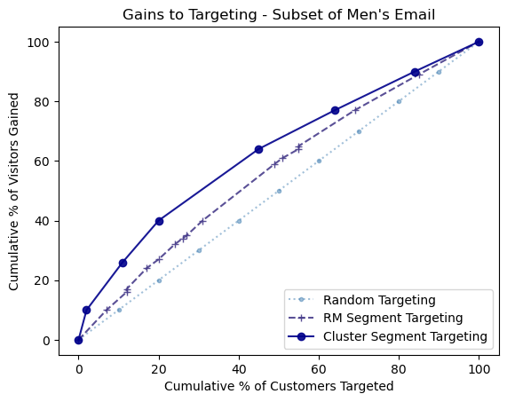
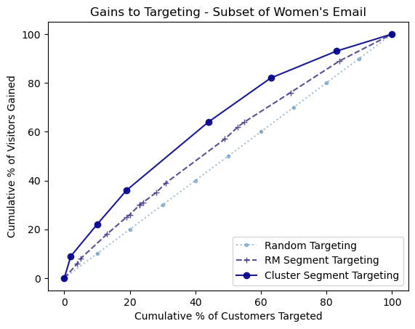
COMPARING GAINS TO TARGETING - BY CAMPAIGN EXPOSURE

Slide 30
STATISTICAL SIGNIFICANCE TESTING
Segment | Ad Campaign ( % Visited | # Total Customers ) |  |  | Z-test (95% C.I.)
 | Men's Campaign | Women's Campaign | None | Men’s vs. Women’s | Men’s vs. None | Women’s vs. None
1 | 89% | 449 | 88% | 337 | 6% | 595 | N | Y | Y
2 | 31% | 1964 | 23% | 1851 | 7% | 3089 | Y | Y | Y
3 | 29% |1913 | 24% | 1900 | 18% | 1912 | Y | Y | Y
4 | 17% | 5204 | 17% | 5316 | 11% | 5191 | N | Y | Y
5 | 13% | 4197 | 14% | 4163 | 7% | 4070 | N | Y | Y
6 | 12% | 4136 | 8% | 4214 | 9% | 3922 | Y | Y | N
7 | 11% | 3444 | 7% | 3606 | 17% | 2527 | Y | Y | Y
For % Visited for segments compared within column,
- Y denotes statistically significant difference
- N denotes otherwise
Link to original slide

Slide 31
TH NK YOU!!!

